Slide 1
RNNs, LSTMs, and Neural Networks
ADS

Slide 2
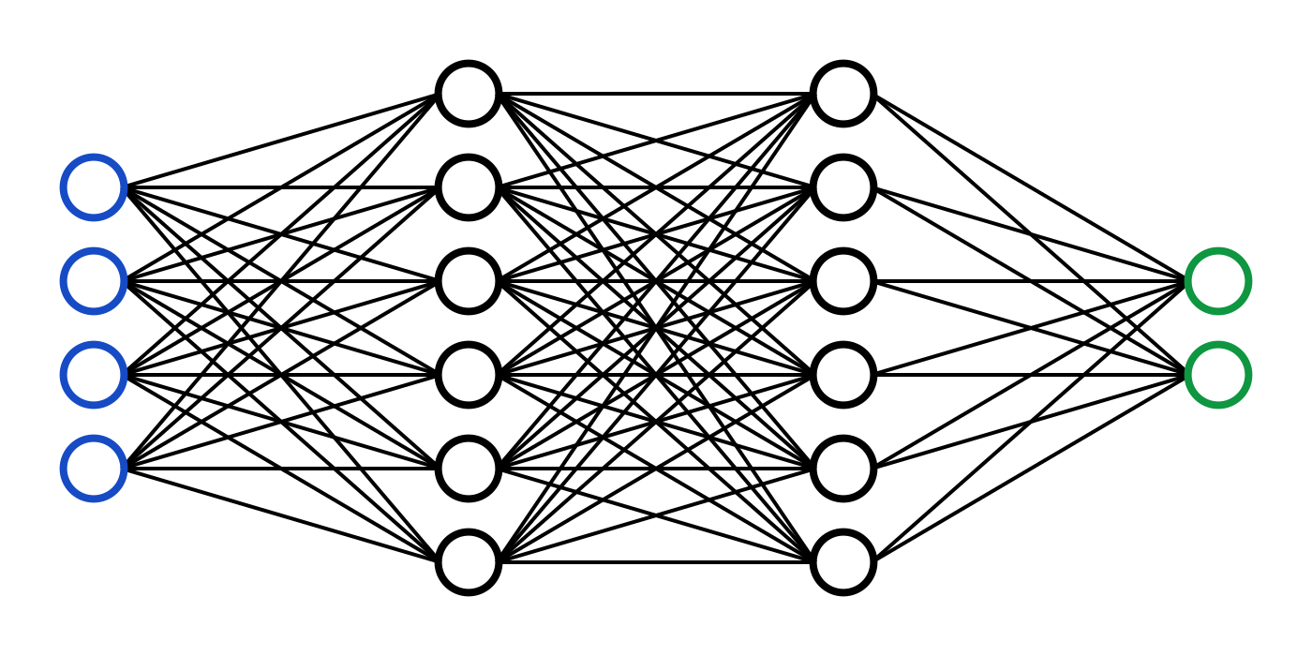
What are Neural Networks?
Neural networks are a class of machine learning algorithms inspired by the structure and function of the human brain.
They consist of layers of interconnected nodes (neurons) that process input data to produce output predictions.
Neural networks are used for a wide range of tasks, including image recognition, natural language processing, and time series prediction.

Slide 3
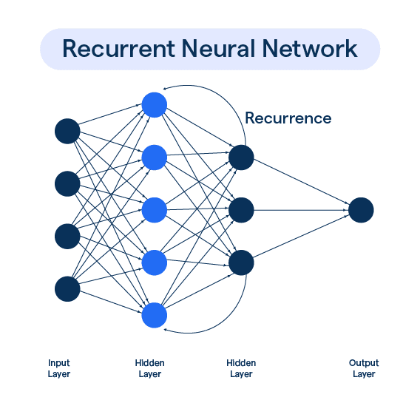
Recurrent Neural Networks (RNNs)
RNNs are a type of neural network designed for sequential data, such as time series or text.
They have connections that form a directed cycle, allowing information to persist over time.
RNNs are suitable for tasks where the context of previous inputs is important, such as speech recognition and language modeling.

Slide 4
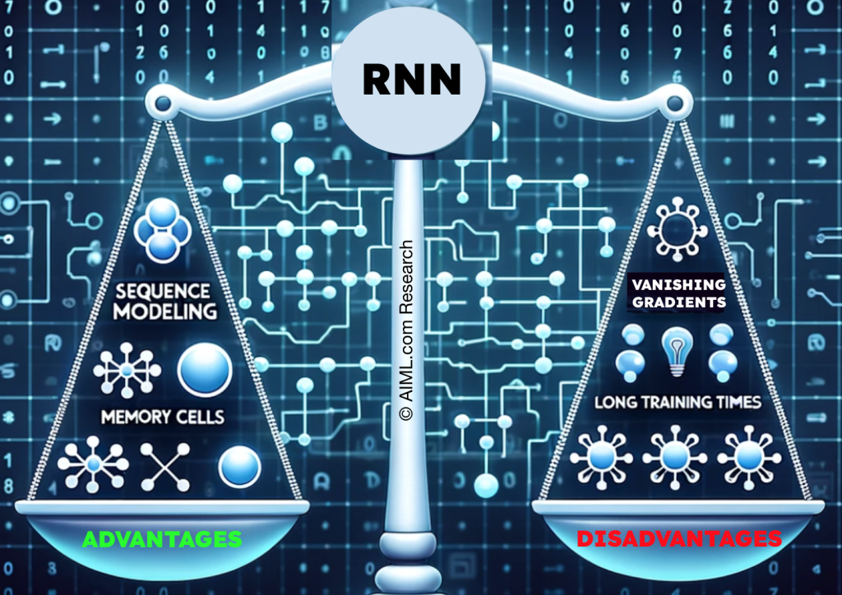
Limitations of RNNs
RNNs can model sequential dependencies, but they struggle with long-term dependencies.
This is due to the vanishing gradient problem, where gradients become increasingly small as they propagate back through time.
As a result, RNNs have difficulty learning from inputs that are far in the past.

Slide 5
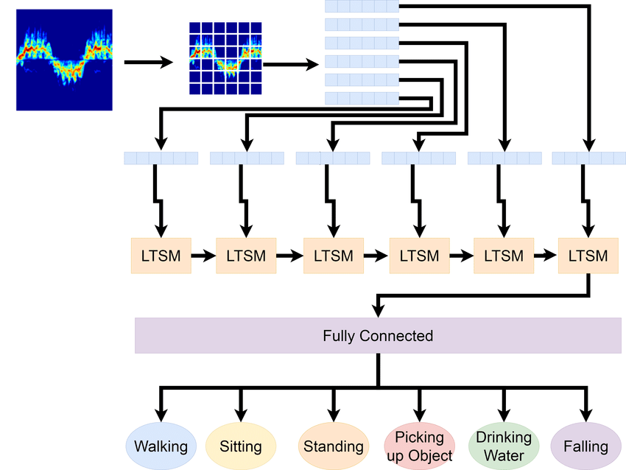
Long Short-Term Memory (LSTM) Networks
LSTMs are a variant of RNNs designed to address the vanishing gradient problem.
They introduce specialized units called memory cells that can retain information over long periods.
LSTMs use gates to control the flow of information, allowing them to learn long-term dependencies more effectively.

Slide 6
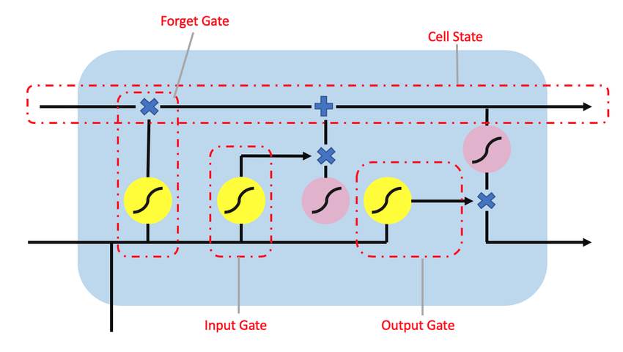
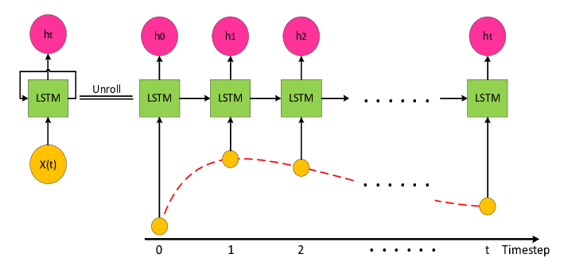
LSTM Architecture
Application of LSTMs
LSTMs are widely used in tasks requiring modeling of long-term dependencies, such as speech recognition, machine translation, and sentiment analysis.
They are particularly effective for tasks involving time series prediction, where they can learn patterns over extended periods
An LSTM cell consists of three gates: input gate, forget gate, and output gate.
The input gate controls the flow of new information into the cell.
The forget gate determines which information to discard from the cell's memory.
The output gate regulates the information that the cell sends to the next time step.

Slide 7
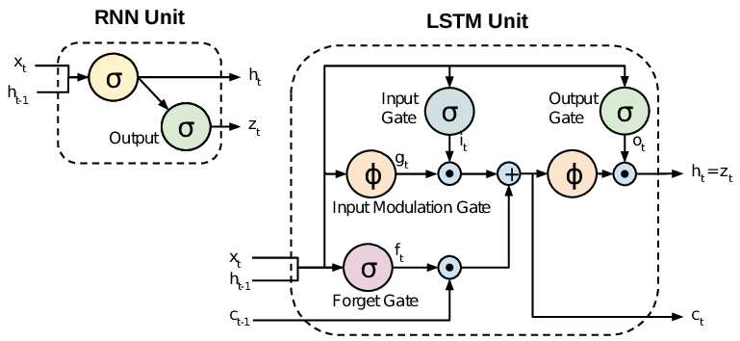
RNNs vs LSTMs (Visualized)

Slide 8
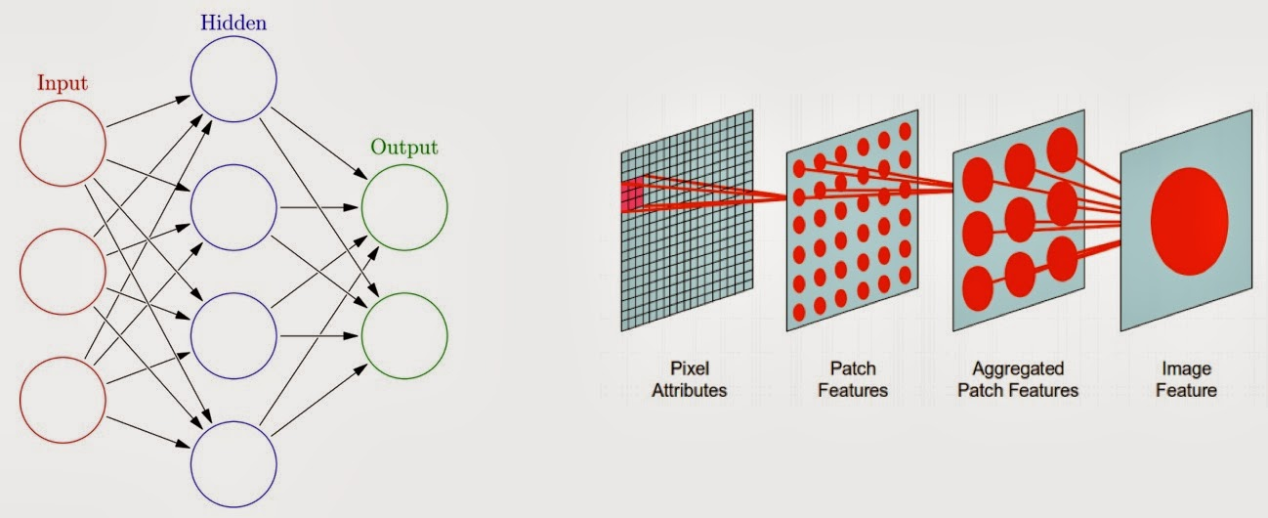
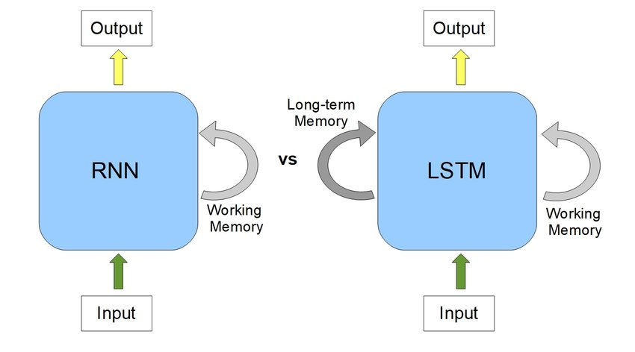
Conclusion
RNNs, LSTMs, and neural networks are powerful tools for processing sequential data and learning complex patterns.
While RNNs have limitations with long-term dependencies, LSTMs address these limitations and are widely used in various applications.
Understanding these concepts is essential for anyone working in the field of deep learning and artificial intelligence.
https://www.youtube.com/watch?v=aircAruvnKk

Slide 9


Our Socials/Join our Discord:
Instagram: @clt_ads
Linktree: https://shorturl.at/jkqKM
GitHub: https://github.com/DylanABenson24/
UNCC_Data-Science_Association

